Slide 1
Process Synchronization

Slide 2
Contents
Critical Section
Semaphore
Monitor
Thread Synchronization in Nachos
demo1：Bounded-Buffer Problem

Slide 3
Critical Section
Sharing in Concurrent Processes
address space shared by concurrent threads in a process
shared memory can be arranged and shared by UNIX processes although they do not share address spaces
Problems with Shared Variables
possible context switch by time-out at end of every instruction
Data may become inconsistent if shared variables are updated without proper control.

Slide 4
Critical Section
For example: two threads update a shared variable counter.
Thread A Thread B
{ {
. . . . . .
counter++; --counter;
. . . . . .
} }
The machine code translated by gcc for MIPS computer
Thread A Thread B
. . . . . .
lw $2,counter lw $4,counter
addu $3,$2,1 addu $5,$4,-1
sw $3,counter sw $5,counter
. . . . . .

Slide 5
初始时 counter=5
因为Nachos线程切换，实际指令执行顺序为：
lw $2,counter Thread A
addu $3,$2,1 Thread A
lw $4,counter Thread B
addu $5,$4,-1 Thread B
sw $3,counter Thread A counter=6
sw $5,counter Thread B counter=4
the instructions of two threads could interleaved in certain ways.

Slide 6
Critical Section
Critical Section
Code section to be executed by at most one process at a time
A high-level language concept and structure to
enable one thread to execute the code section
while blocking other threads trying to execute it
Controlled by
entry code for entering
exit code after exiting

Slide 7
Critical Section
Common model of critical section
repeat
critical section
remaining section
until false;
The key problem is how to design the code in boxes the
“Entry Section” and ”Exit Section”
Entry Section
Exit Section

Slide 8
Critical Section
Hardware Solution with Test-and-Set Instruction
Test-and-Set instruction: an atomic instruction to do
1. read and return the Boolean value of the lock
2. set the value of the lock to be true
Critical Section
repeat
while Test-and-Set(Lock) do no-op;
critical section;
Lock = false;
remaining section;
until false
Problem
Rely on busy-waiting, which wastes CPU cycles
Complicated for application programmers to use

Slide 9
Contents
Critical Section
Semaphore
Monitor
Thread Synchronization in Nachos

Slide 10
Semaphore
Semaphore is a special data type for process synchronization in operating systems.
It normally has two private data members
an integer s to represent the value of the semaphore
a process queue to accommodate processes or threads blocked on the semaphore.
methods (operations)
P() (Wait() in the text)
V() (Signal() in the text)
Both P() and V() methods are atomic.
Interrupt is disabled during the execution of each method(…)

Slide 11
Semaphore
Semaphore Algorithm 1 (used in the textbook)
P() // wait
s = s - 1;
if (s < 0)
block current process and put it in the queue;
V() // signal
s = s + 1;
if (s <= 0)
remove a process from the queue and wake it up;
Notes:
Note that in this implementation, semaphore values may be negative, whereas semaphore values are never negative under the classical definition of
Semaphores with busy waiting. If a semaphore value is negative, its magnitude is the number of processes waiting on that semaphore. This fact results from
switching the order of the decrement and the test in the implementation of the wait() operation.

Slide 12
Semaphore
Semaphore Algorithm 2 (used in Nachos)
P() // wait
while (s = 0)
block current process and put it in the queue;
s = s - 1;
V() // signal
if (the queue is non-empty)
remove a process from the queue and wake it up;
s = s + 1;
Notes:
semaphore value, always s >= 0
P() -- waits until value > 0, then decrement
V() -- increment, waking up a thread waiting in P() if necessary

Slide 13
Semaphore
Bounded Buffer Problem - A classical problem in operating systems and networking
Producer processes put data items into the buffer
Consumer processes get the data items from the buffer
Shared buffer with n slots to store at most n items
Variable in points to the first empty slot in the buffer
Variable out points to the first valid item in the buffer
Producer Process
repeat
produce an item in nextp;
entry synchronization;
buffer[in] = nextp;
in = in + 1 mod n;
exit synchronization;
remaining section;
until false
Consumer Process
repeat
entry synchronization;
nextc = buffer[out];
out = out + 1 mod n;
exit synchronization;
consume the item nextc;
remaining section;
until false

Slide 14
Semaphore
Synchronization Required
critical section for operations on shared buffer and its pointers
consumer should be blocked when buffer is empty
producer should be blocked when buffer is full
Critical Section
use a semaphore for the critical sections in both producer and consumer
Semaphore *mutex = new Semaphore(''mutex'', 1);

Slide 15
Semaphore
Emptiness Control
Producers reduce the emptiness
Consumers increase the emptiness
There are n empty slots initially
Use a semaphore to block producers when emptiness is reduced to zero
Semaphore *nEmpty = new Semaphore(''nEmtpy'', n);
Fullness Control
Producers increase the fullness
Consumers reduce the fullness
There are 0 full slots initially
Use a semaphore to block consumers when fullness is reduced to zero
Semaphore *nFull = new Semaphore(''nFull'', 0);

Slide 16
Semaphore
Producer Process
repeat
produce an item in nextp;
nEmpty->P();
mutex->P();
buffer[in] = nextp;
in = in + 1 mod n;
mutex->V();
nFull->V();
remaining section;
until false
Consumer Process
repeat
nFull->P();
mutex->P();
nextc = buffer[out];
out = out + 1 mod n;
mutex->V();
nEmpty->V();
consume the item nextc;
remaining section;
until false
Notes:
注意生产者和消费者之间的对称性。
生产者为消费者生成满的缓冲区，消费者为生产者生成空的缓冲区

Slide 17
Semaphore
The order of semaphore operations is important.
What may happen to the following code?
Producer Process
repeat
produce an item in nextp;
mutex->P();
nEmpty->P();
buffer[in] = nextp;
in = in + 1 mod n;
nFull->V();
mutex->V();
remaining section;
until false
Consumer Process
repeat
mutex->P();
nFull->P();
nextc = buffer[out];
out = out + 1 mod n;
nEmpty->V();
mutex->V();
consume the item nextc;
remaining section;
until false
应先执行对资源信号量的P操作，然后再执行对互斥信号量的P操作
Notes:
以初始状态为例：mutex值为1，nEmpty值为n，nFull值为0.
若Producer Process先执行，没问题。
若Consumer Process先执行，执行mutex->P()后，mutex减为0，这将使Producer Process进入时阻塞在mutex->P()这一行，无法到达nFull->V()这行，从而阻止nFull值从0变为1，也就导致了Consumer Process阻塞在nFull->P()这行无法脱离，双方陷入死锁

Slide 18
Semaphore
Dining Philosopher Problem
a round table with 5 dining philosophers
one chop-stick between neighboring philosophers
philosophers' process
for (;;) {
thinking;
pick up both left and right chopstick;
eating;
put down both left and right chopstick;
}
Solution using semaphores
one semaphore with value 1 for each chop-stick
use P() for action of picking up (acquire) chop-stick
use V() for action of putting down (release) chop-stick

Slide 19
Semaphore
Philosopher i
while (true) {
P ( chopstick[i] );
P ( chopstick[ (i + 1) % 5] );
// eat
V ( chopstick[i] );
V (chopstick[ (i + 1) % 5] );
// think
}
Possible Deadlock！

Slide 20
Dining-Philosophers Problem
Although this solution guarantees that no two neighbors are eating simultaneously, it nevertheless must be rejected because it could create a deadlock.
Suppose that all five philosophers become hungry at the same time and each grabs her left chopstick. All the elements of chopstick will now be equal to 0. When each philosopher tries to grab her right chopstick, she will be delayed forever.

Slide 21
Possible Remedies to the Deadlock Problem
Allow at most 4 philosophers to be sitting simultaneously at the table.
Allow a philosopher to pick up her chopsticks only if both chopsticks are available (to do this, she must pick them up in a critical section).
Use an asymmetric solution—that is, an odd-numbered philosopher picks up first her left chopstick and then her right chopstick, whereas an even numbered philosopher picks up her right chopstick and then her left chopstick.

Slide 22
Contents
Critical Section
Semaphore
Monitor
Thread Synchronization in Nachos

Slide 23
Monitor
Monitor
A special abstract data type whose function (method) invocations are guaranteed to be mutually exclusive.
With an implicit lock (semaphore) to control mutual exclusion
Notes:
信号量机制的缺点：进程自备同步操作，P(S)和V(S)操作大量分散在各个进程中，不易管理，易发生死锁。1974年和1977年，Hore和Hansen提出了管程。
管程特点：管程封装了同步操作，对进程隐蔽了同步细节，简化了同步功能的调用界面。用户编写并发程序如同编写顺序(串行)程序。
引入管程机制的目的：1、把分散在各进程中的临界区集中起来进行管理；2、防止进程有意或无意的违法同步操作；3、便于用高级语言来书写程序，也便于程序正确性验证。

Slide 24
Monitor
Condition Variable
A monitor won't be useful without condition variables
Represent the condition for which several concurrent processes may be waiting
two operations (methods)
wait() : cause the calling process (thread) to block (wait) at this condition variable
signal() : if there is a process (thread) blocking (waiting) at this condition variable, wake it up; otherwise do nothing

Slide 25
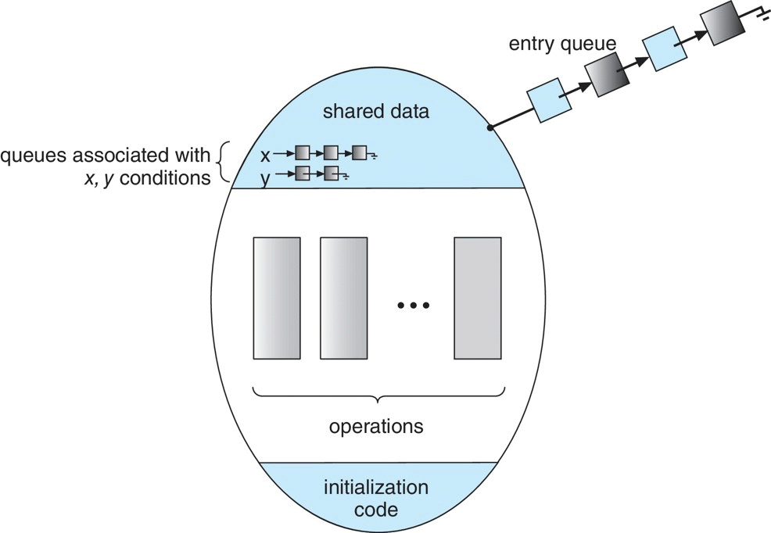
Monitor with Condition Variables
monitor_name
注：入口队列中的箭头方向是其数据结构中指针的方向，而非入口进程移动的方向
管程是特殊的模块
每个管程有一个名字
由关于共享资源的数据结构及在其上操作的一组过程组成
进程只能通过调用管程中的过程来间接地访问管程中的数据结构

Slide 26
Monitor
Two styles of Monitor
Consider that process P calls signal() of a condition variable and wakes up process Q.
Hoare style
Q continues immediately and P suspends itself
advantage: condition is guaranteed to be satisfied when Q resumes, so can use if to check the condition (does not need to re-check the condition)
disadvantage: high context-switch overhead
Mesa style
P continues, and Q is moved to queue and continues later
disadvantage: condition may not be satisfied when Q resumes, so need while loop to check the condition again
advantage: more efficient

Slide 27
信号量与条件变量功能的比较
Semaphore:
wait() 操作不总是阻塞调用者。例如，当信号量计数的值>=0
signal() 总是增加信号量的值，如果有进程阻塞就唤醒阻塞进程
如果 signal() 操作释放一个阻塞进程，调用 者进程和被唤醒者进程将并发执行
可以在程序的任何地方使用，但不能用于管程的条件同步
Condition Variables:
Wait() 操作总是阻塞调用者
Signal() 操作要么唤醒阻塞进程，如果有进 程阻塞。要么就什么也不做
如果 Signal() 操作唤醒一个阻塞进程，可能 有两种执行方式：
调用者继续执行，被唤醒者继续睡眠， 直到调用者离开管程或阻塞后才继续执行( Mesa 样式)
调用者阻塞，被唤醒者立即执行。调用 者直到被唤醒者离开管程或阻塞后才被 唤醒继续执行( Hoare 样式)
仅用于管程的条件同步机制中

Slide 28
Contents
Critical Section
Semaphore
Monitor
Thread Synchronization in Nachos

Slide 29
Thread Synchronization in Nachos
Files:
../threads/synch.h
../threads/synch.cc
Semaphore Class
private member
private:
char* name; // useful for debugging
int value; // semaphore value, always >= 0
List *queue; // threads waiting in P() for the value to be > 0
Functions
void P(); // these are the only operations on a semaphore
void V(); // they are both *atomic*

Slide 30
Thread Synchronization in Nachos
Semaphore Class (continued)
Constructor
Semaphore::Semaphore(char* debugName, int initialValue)
{
name = debugName;
value = initialValue;
queue = new List;
}

Slide 31
Thread Synchronization in Nachos
Semaphore Class (continued)
P( )
void Semaphore::P() {
IntStatus oldLevel = interrupt->SetLevel(IntOff); // disable interrupts
while (value == 0) { // semaphore not available
queue->Append((void *)currentThread); // so go to sleep
currentThread->Sleep();
}
value--; // semaphore available,
// consume its value
(void) interrupt->SetLevel(oldLevel); // re-enable interrupts
}

Slide 32
Thread Synchronization in Nachos
Semaphore Class (continued)
V( )
void Semaphore::V() {
Thread *thread;
IntStatus oldLevel = interrupt->SetLevel(IntOff);
thread = (Thread *)queue->Remove();
if (thread != NULL)
// make thread ready, consuming the V immediately
scheduler->ReadyToRun(thread);
value++;
(void) interrupt->SetLevel(oldLevel);
}

Slide 33
Thread Synchronization in Nachos
Lock Class
binary semaphore with checking of the ownership of the lock
class Lock {
public:
Lock(char* debugName); // initialize lock to be FREE
~Lock(); // deallocate lock
char* getName() { return name; } // debugging assist
void Acquire(); // these are the only operations on a lock
void Release(); // they are both *atomic*
bool isHeldByCurrentThread(); // true if the current thread
// holds this lock. Useful for// checking in Release,
// and in condition variable ops below.
private:
char* name; // for debugging
Thread *owner; // remember who acquired the lock
Semaphore *lock; // use semaphore for the actual lock
};

Slide 34
Thread Synchronization in Nachos
Lock Class (continued)
constructor
Lock::Lock(char* debugName) {
name = debugName;
owner = NULL;
lock = new Semaphore(name,1);
}
function Acquire()
void Lock::Acquire() {
IntStatus oldLevel = interrupt->SetLevel(IntOff); // disable interrupts
lock->P(); // procure the semaphore
owner = currentThread; // record the new owner of the lock
(void) interrupt->SetLevel(oldLevel); // re-enable interrupts
}

Slide 35
Thread Synchronization in Nachos
Lock Class(continued)
function Release()
void Lock::Release()
{
IntStatus oldLevel = interrupt->SetLevel(IntOff); // disable interrupts
// Ensure:
// a) lock is BUSY
// b) this thread is the same one that acquired it.
ASSERT(currentThread == owner);
owner = NULL; // clear the owner
lock->V(); // vanquish the semaphore
(void) interrupt->SetLevel(oldLevel);
}

Slide 36
Thread Synchronization in Nachos
Condition Class
Mesa Style Condition Variable
class Condition {
public:
Condition(char* debugName); // initialize condition to "no one waiting"
~Condition(); // deallocate the condition
char* getName() { return (name); }
void Wait(Lock *conditionLock); // these are the 3 operations on condition variables; releasing
// the ock and going to sleep are *atomic* in Wait()
void Signal(Lock *conditionLock); // conditionLock must be held by
void Broadcast(Lock *conditionLock); // the currentThread for all of
// these operations
private:
char* name;
List* queue; // threads waiting on the condition
Lock* lock; // debugging aid: used to check correctness of
// arguments to Wait, Signal and Broacast
};

Slide 37
Thread Synchronization in Nachos
Condition Class (continued)
function Wait(Lock* conditionLock)
void Condition::Wait(Lock* conditionLock) {
IntStatus oldLevel = interrupt->SetLevel(IntOff);
ASSERT(conditionLock->isHeldByCurrentThread()); // check pre-condition
if(queue->IsEmpty())
lock = conditionLock; // helps to enforce pre-condition
ASSERT(lock == conditionLock); // another pre-condition
queue->Append(currentThread); // add this thread to the waiting list
conditionLock->Release(); // release the lock
currentThread->Sleep(); // goto sleep
conditionLock->Acquire(); // awaken: re-acquire the lock
(void) interrupt->SetLevel(oldLevel);
}

Slide 38
Thread Synchronization in Nachos
Condition Class (continued)
function Signal(Lock* conditionLock)
void Condition::Signal(Lock* conditionLock) {
Thread *nextThread;
IntStatus oldLevel = interrupt->SetLevel(IntOff);
ASSERT(conditionLock->isHeldByCurrentThread());
if(!queue->IsEmpty()) {
ASSERT(lock == conditionLock);
nextThread = (Thread *)queue->Remove();
scheduler->ReadyToRun(nextThread); // wake up the thread
}
(void) interrupt->SetLevel(oldLevel);
}

Slide 39
Thread Synchronization in Nachos
Condition Class (continued)
function Broadcast(Lock* conditionLock)
void Condition::Broadcast(Lock* conditionLock) {
Thread *nextThread;
IntStatus oldLevel = interrupt->SetLevel(IntOff);
ASSERT(conditionLock->isHeldByCurrentThread());
if(!queue->IsEmpty()) {
ASSERT(lock == conditionLock);
while(nextThread = (Thread *)queue->Remove()) {
scheduler->ReadyToRun(nextThread); // wake up the threads
}
}
(void) interrupt->SetLevel(oldLevel);
}

Slide 40
Thread Synchronization in Nachos
Use of Monitors (example)
Files
..threads/synchlist.h
.. threads/synchlist.cc
A synchronized linked list class in Nachos called SynchList to be accessed by multiple threads.
actually implemented as a monitor with mesa style condition variables.

Slide 41
Thread Synchronization in Nachos
SynchList Class
class SynchList {
public:
SynchList(); // initialize a synchronized list
˜SynchList(); // de-allocate a synchronized list
void Append(void *item); // append item to the end of the list,
// and wake up any thread waiting in remove
void *Remove(); // remove the first item from the front of
// the list, waiting if the list is empty
void Mapcar(VoidFunctionPtr func); // apply function to every item in the list
private:
List *list; // the unsynchronized list
Lock *lock; // enforce mutual exclusive access to the list
Condition *listEmpty; // wait in Remove if the list is empty
};

Slide 42
Thread Synchronization in Nachos
SynchList Class (continued)
Function Remove()
void * SynchList::Remove() {
void *item;
lock->Acquire(); // enforce mutual exclusion
while (list->IsEmpty())
listEmpty->Wait(lock); // wait until list isn’t empty
item = list->Remove();
ASSERT(item != NULL);
lock->Release();
return item;
}

Slide 43
Thread Synchronization in Nachos
SynchList Class (continued)
Function Append(void *item)
void SynchList::Append(void *item)
{
lock->Acquire(); // enforce mutual exclusive // access to the list
list->Append(item);
listEmpty->Signal(lock); // wake up a waiter, if any
lock->Release();
}

Slide 44
附录：Bounded-Buffer Problem
安装包中的demo1是有限(有界)缓冲问题 (生产者-消费者问题)的一个参考实现，含源码
其实现的一些具体参数如下：
缓冲区大小为3
2个生产者
2个消费者
每个生产者生产5条消息
在完成Lab3时，可参考demo1

Slide 45
附录：Bounded-Buffer Problem
可输入下面的命令行，进行测试：
./nachos -rs 123
cat tmp_0
cat tmp_1

Slide 46
附录：Bounded-Buffer Problem
$ ./nachos -rs 123
No threads ready or runnable, and no pending interrupts.
…
Cleaning up...
$ cat tmp_0
producer id --> 0; Message number --> 0;
producer id --> 0; Message number --> 1;
producer id --> 0; Message number --> 3;
producer id --> 0; Message number --> 4;
producer id --> 1; Message number --> 1;
producer id --> 1; Message number --> 3;
$ cat tmp_1
producer id --> 0; Message number --> 2;
producer id --> 1; Message number --> 0;
producer id --> 1; Message number --> 2;
producer id --> 1; Message number --> 4;

Slide 47
Thanks!

